Slide 1
MEA1_002

Slide 2
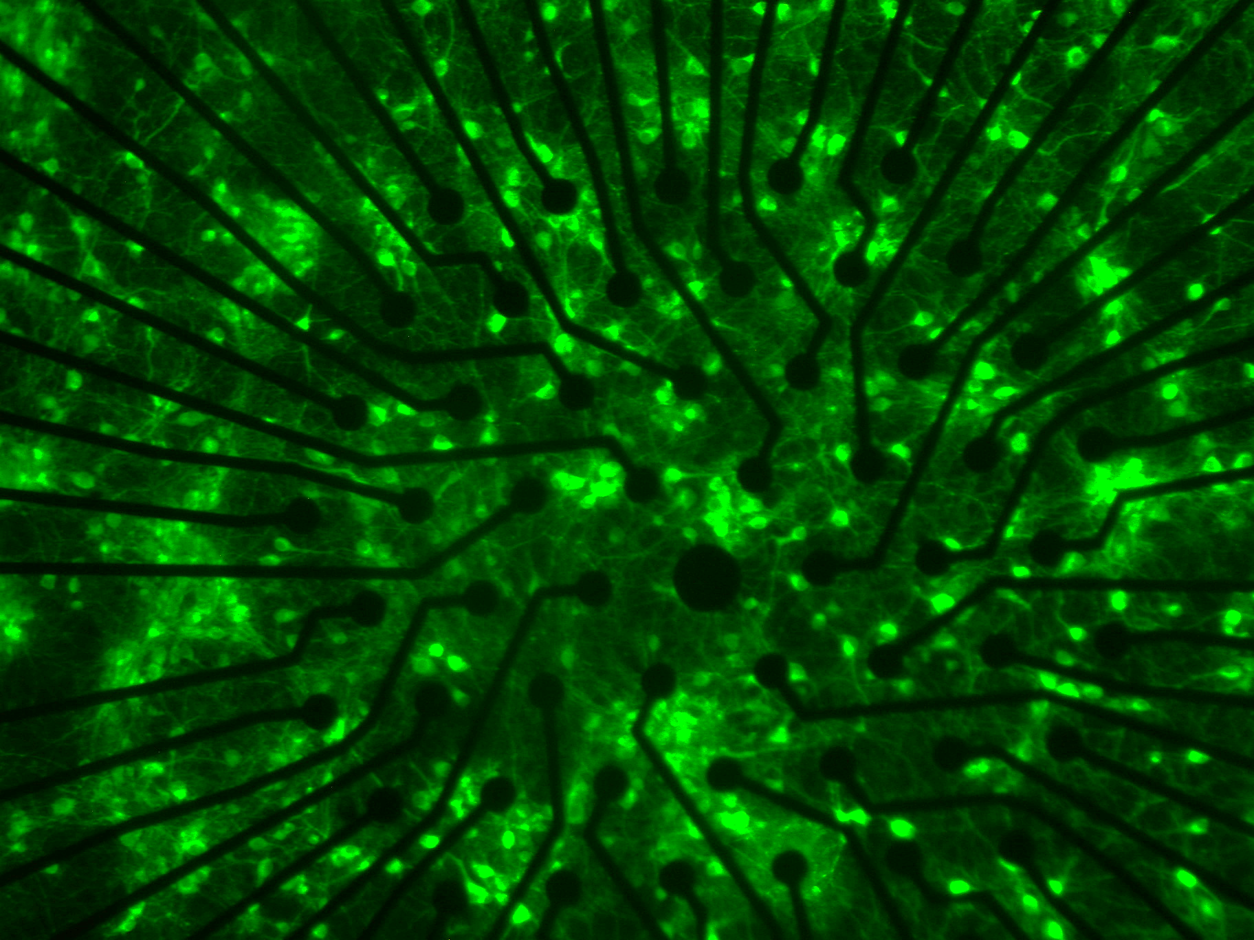

Slide 3
There is a missing part from Flou
MEA1_003

Slide 4
There is a missing part from Flou
MEA1_004

Slide 5
There is a missing part from Flou
MEA1_006

Slide 6
MEA1_008
MEA1_009

Slide 7
MEA1_0012
MEA1_0017

Slide 8
MEA1_0041
The missing part from Flou

Slide 9
MEA1_0019
MEA1_0023

Slide 10
MEA1_0020
MEA1_0021

